Slide 1
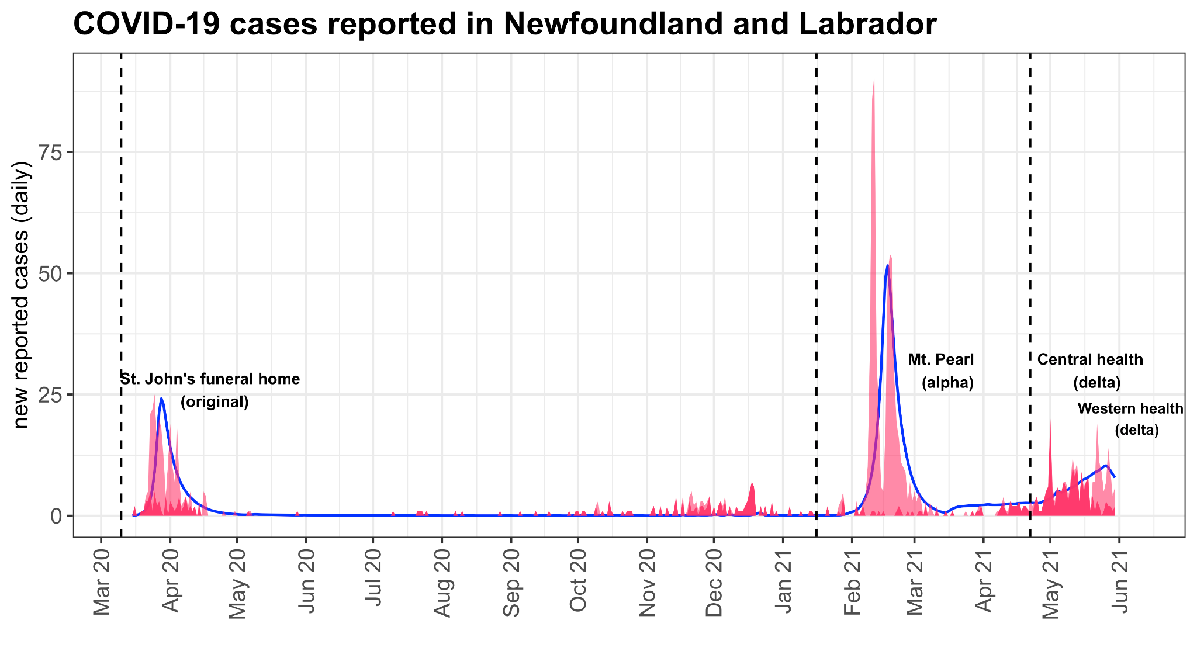








Pandemic preparedness needs modelling preparedness What the COVID-19 pandemic taught us about the modelling, the philosophy, and the profession
Amy Hurford

Slide 2
What the COVID-19 pandemic taught modellers about future pandemic preparedness
Technical issues that need to be considered to do modeling to support all jurisdictions
Pitfall1: atto-fox
Pitfall 2: island of Transmithica
Pitfall 3: over-generalization
Fixes
Modelling philosophy
Mechanistic vs. statistical
Agent-based vs. compartmental
Space stations vs. fire stations
The profession: modellers in pandemic decision support

Slide 3
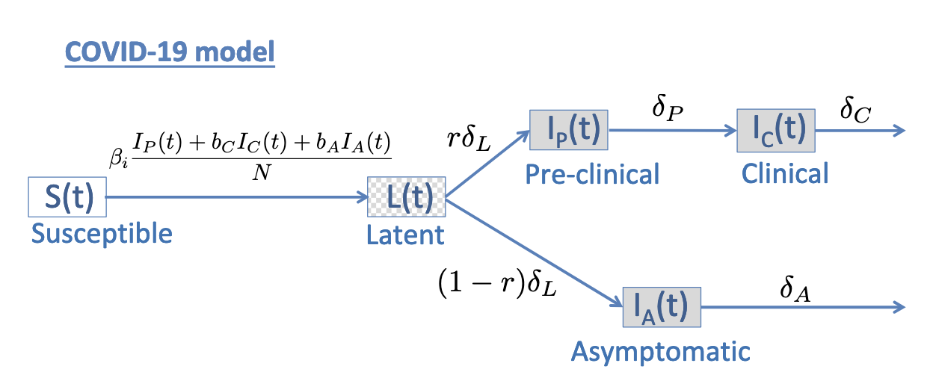
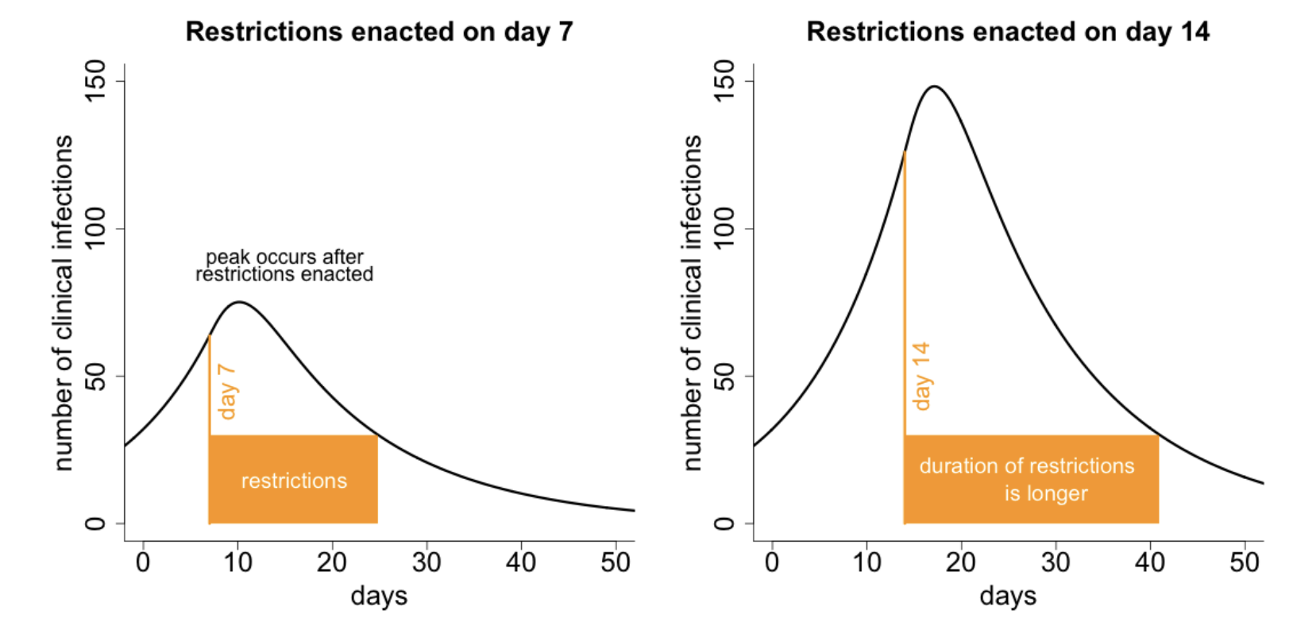
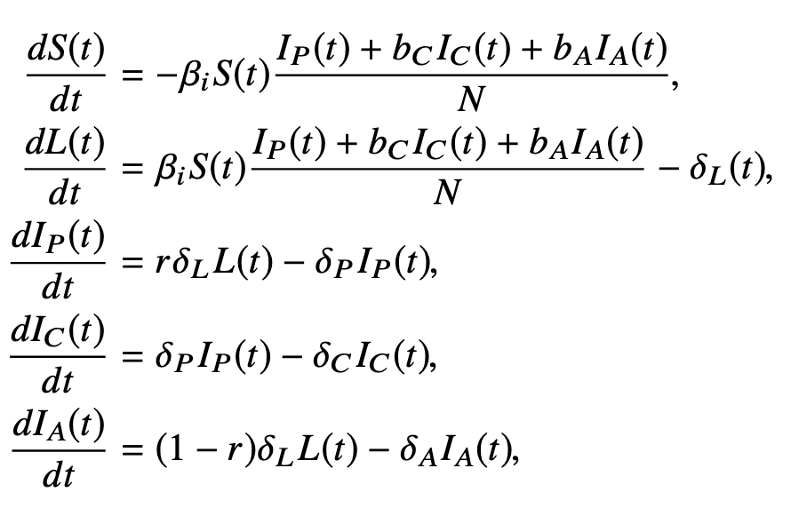
The types of models affected by the pitfalls are not bad approaches (compartmental models, ODEs, and continuous dependent variables)
Hurford and Watmough. 2021. Don’t wait, re-escalate: delayed action results in longer duration of COVID-19 measures. MedRxiv

Slide 4
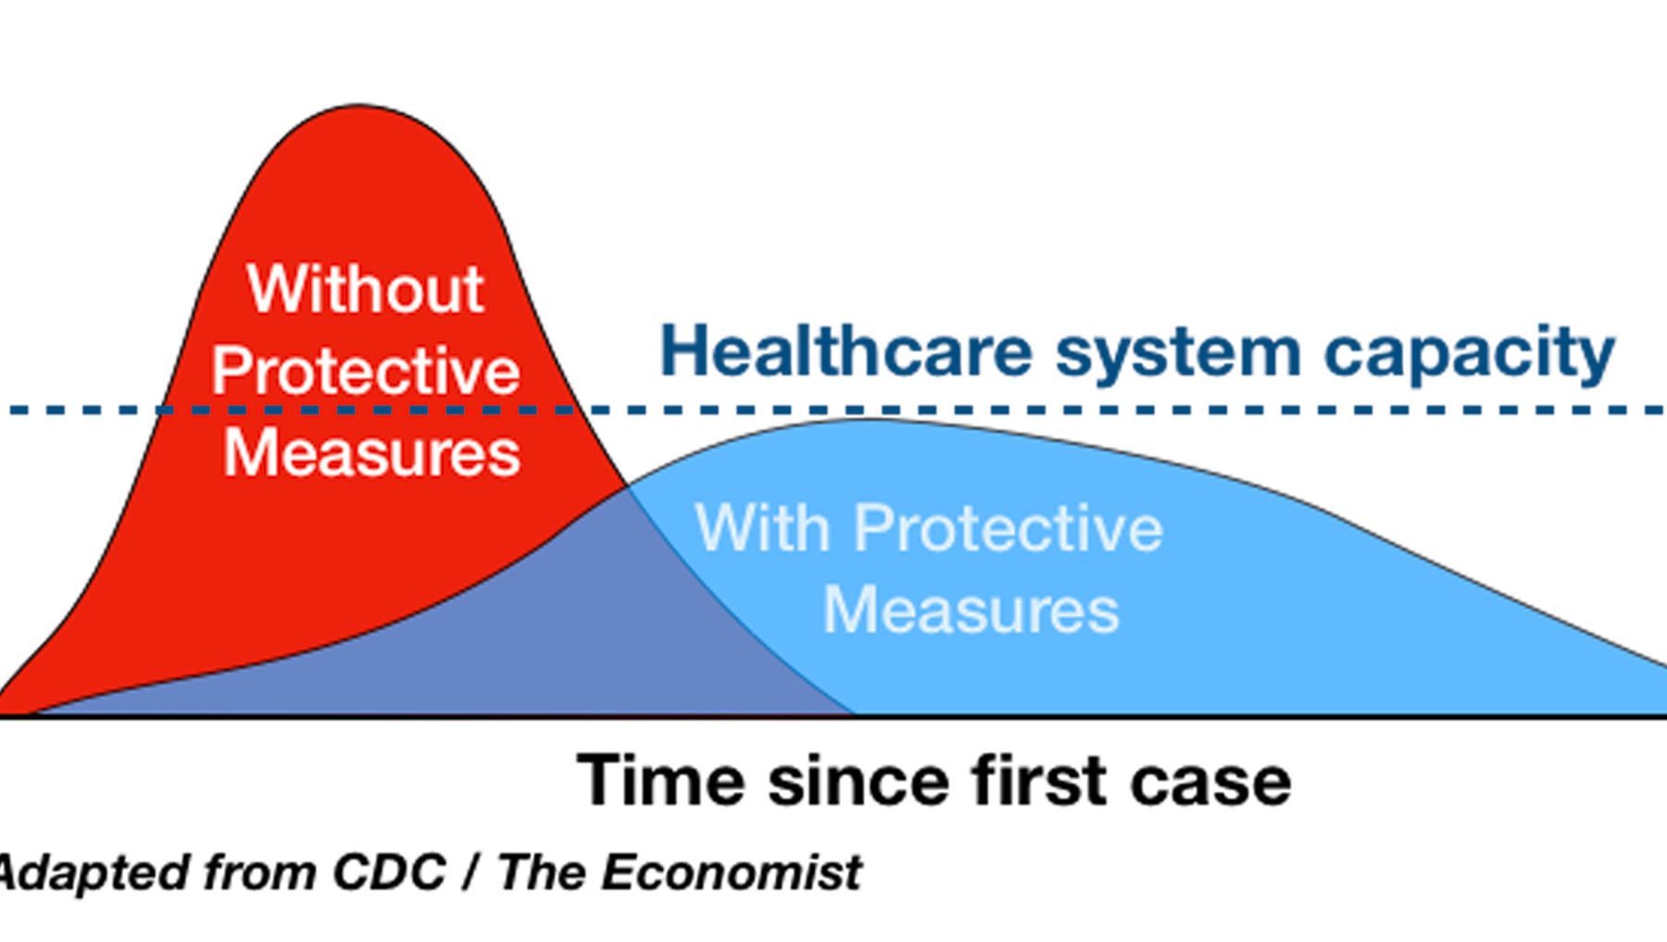
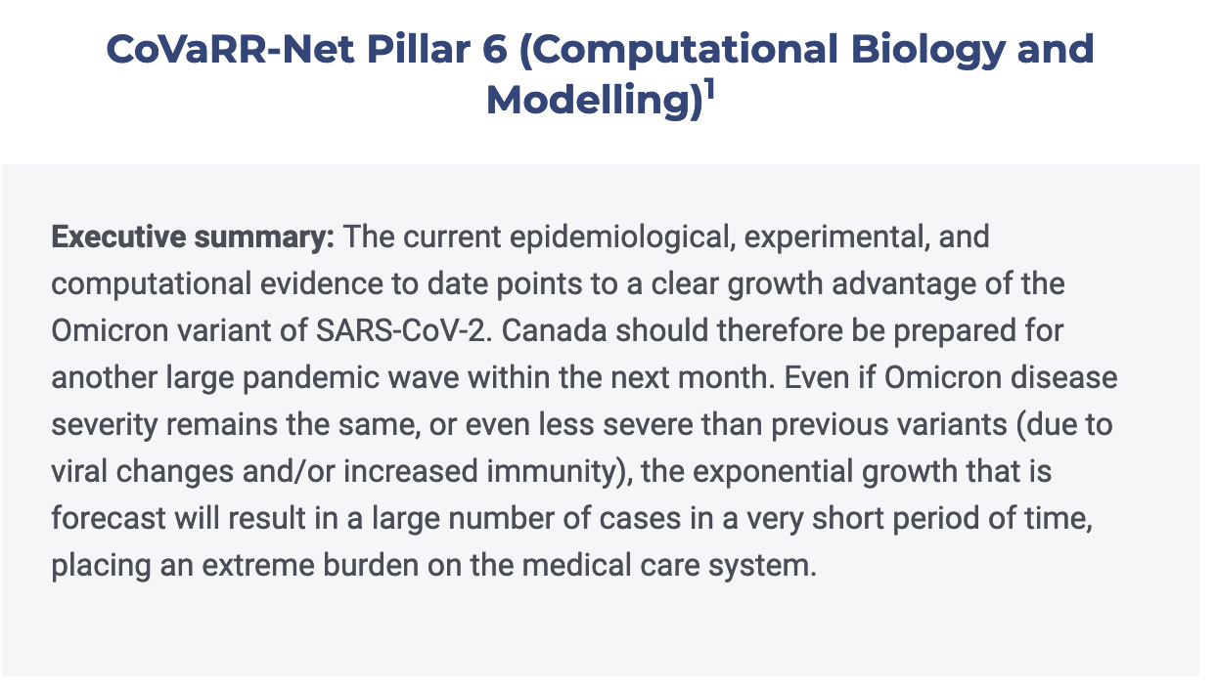
Simple models are valuable as “stylized facts” for communication to non-modellers
The types of models affected by the pitfalls are not bad approaches (compartmental models, ODEs, and continuous dependent variables)
Flatten the curve
Omicron (less severe, more transmissible) was forecast to place an extreme burden on the healthcare system

Slide 5
The types of models affected by the pitfalls are not bad approaches (compartmental models, ODEs, and continuous dependent variables)
Feasibility of fitting and sensitivity analysis is a strength of fast models, i.e. ODEs
Consider a model:
20 parameters (no means unusual in ecology/epidemiology)
10 values of each parameter
1 second per model run
Number of required runs: 10²⁰ = 100,000,000,000,000,000,000
Start time: immediately after Big Bang
Current status: 0.4% complete
Argument is from Dietz (2017) Ecological forecasting, p140

Slide 6
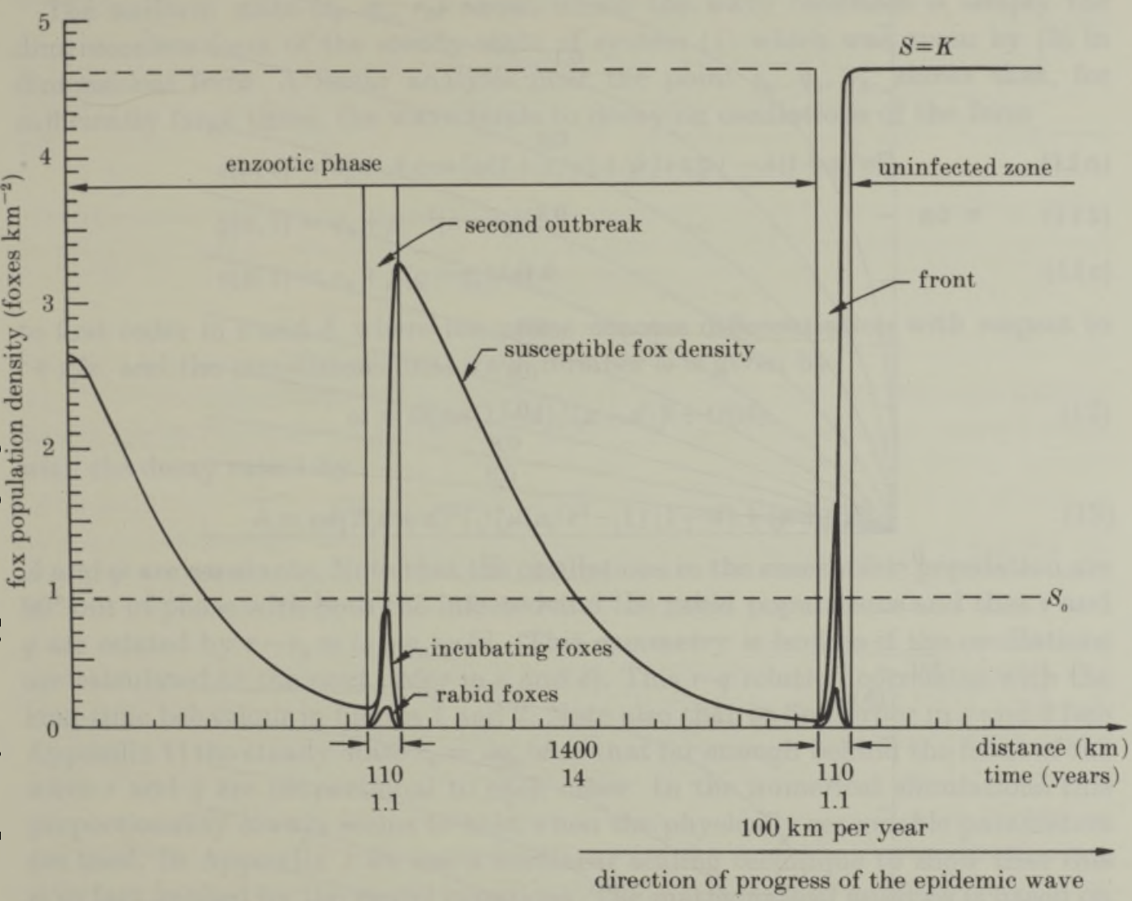
Murray et al. 1986: rabies would re-appear in south England 6 years later
Main conclusions of Murray et al. 1986 are based on a technical error: the atto-fox (Mollison 1991)
Aside from the error, Murray et al. 1986 is quite inspiring
Murray et al. 1986. On the spatial spread of rabies among foxes

Slide 7
Continuous dependent variables cause the atto-fox problem
“As to the second wave, close inspection shows that the explanation lies not so much in the determinism of the model as in its modeling of the population as continuous rather than discrete and its associated inability to let population variables reach the value zero”
“.. The density of infected [foxes] … declines to a minimum of around one atto-fox (10⁻¹⁸ of a fox) per square kilometer. The model then allows this atto-fox to start the second wave as soon as the susceptible population has regrown sufficiently.”
Mollison, 1991. Dependence of epidemic and population velocities on basic parameters

Slide 8
Pitfall 1: atto-fox
Concerns models where population variables never reach zero, enabling rebounds from very small values (i.e., 10⁻¹⁸)
Affects modelling concerning:
Public health measures that are released
Elimination strategies, and travel measures
Transmission dynamics involving clusters of cases
Solutions
End the outbreak when a small value is reached (Hansen and Day 2011)
Modelling outbreak duration and time between outbreaks (Martignoni et al. 2024)
Importation-community spread switch model
Hansen and Day. 2011. Optimal control of epidemics with limited resources; Martignoni et al. 2024. Is SARS-CoV-2 elimination or mitigation best? Regional and disease characteristics determine the best strategy

Slide 9
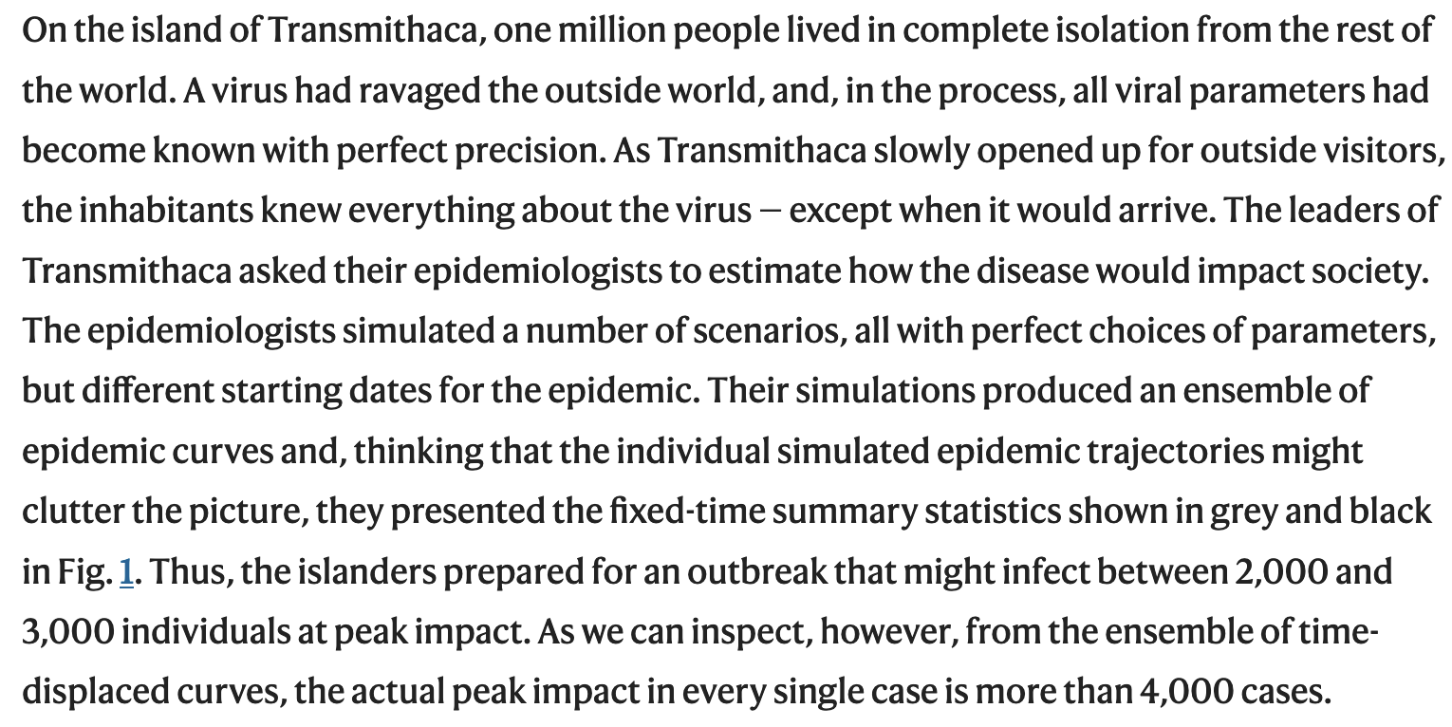
Pitfall 2: island of Transmithica
Juul et al. 2021 Fixed-time descriptive statistics underestimate extremes of epidemic curve ensembles

Slide 10
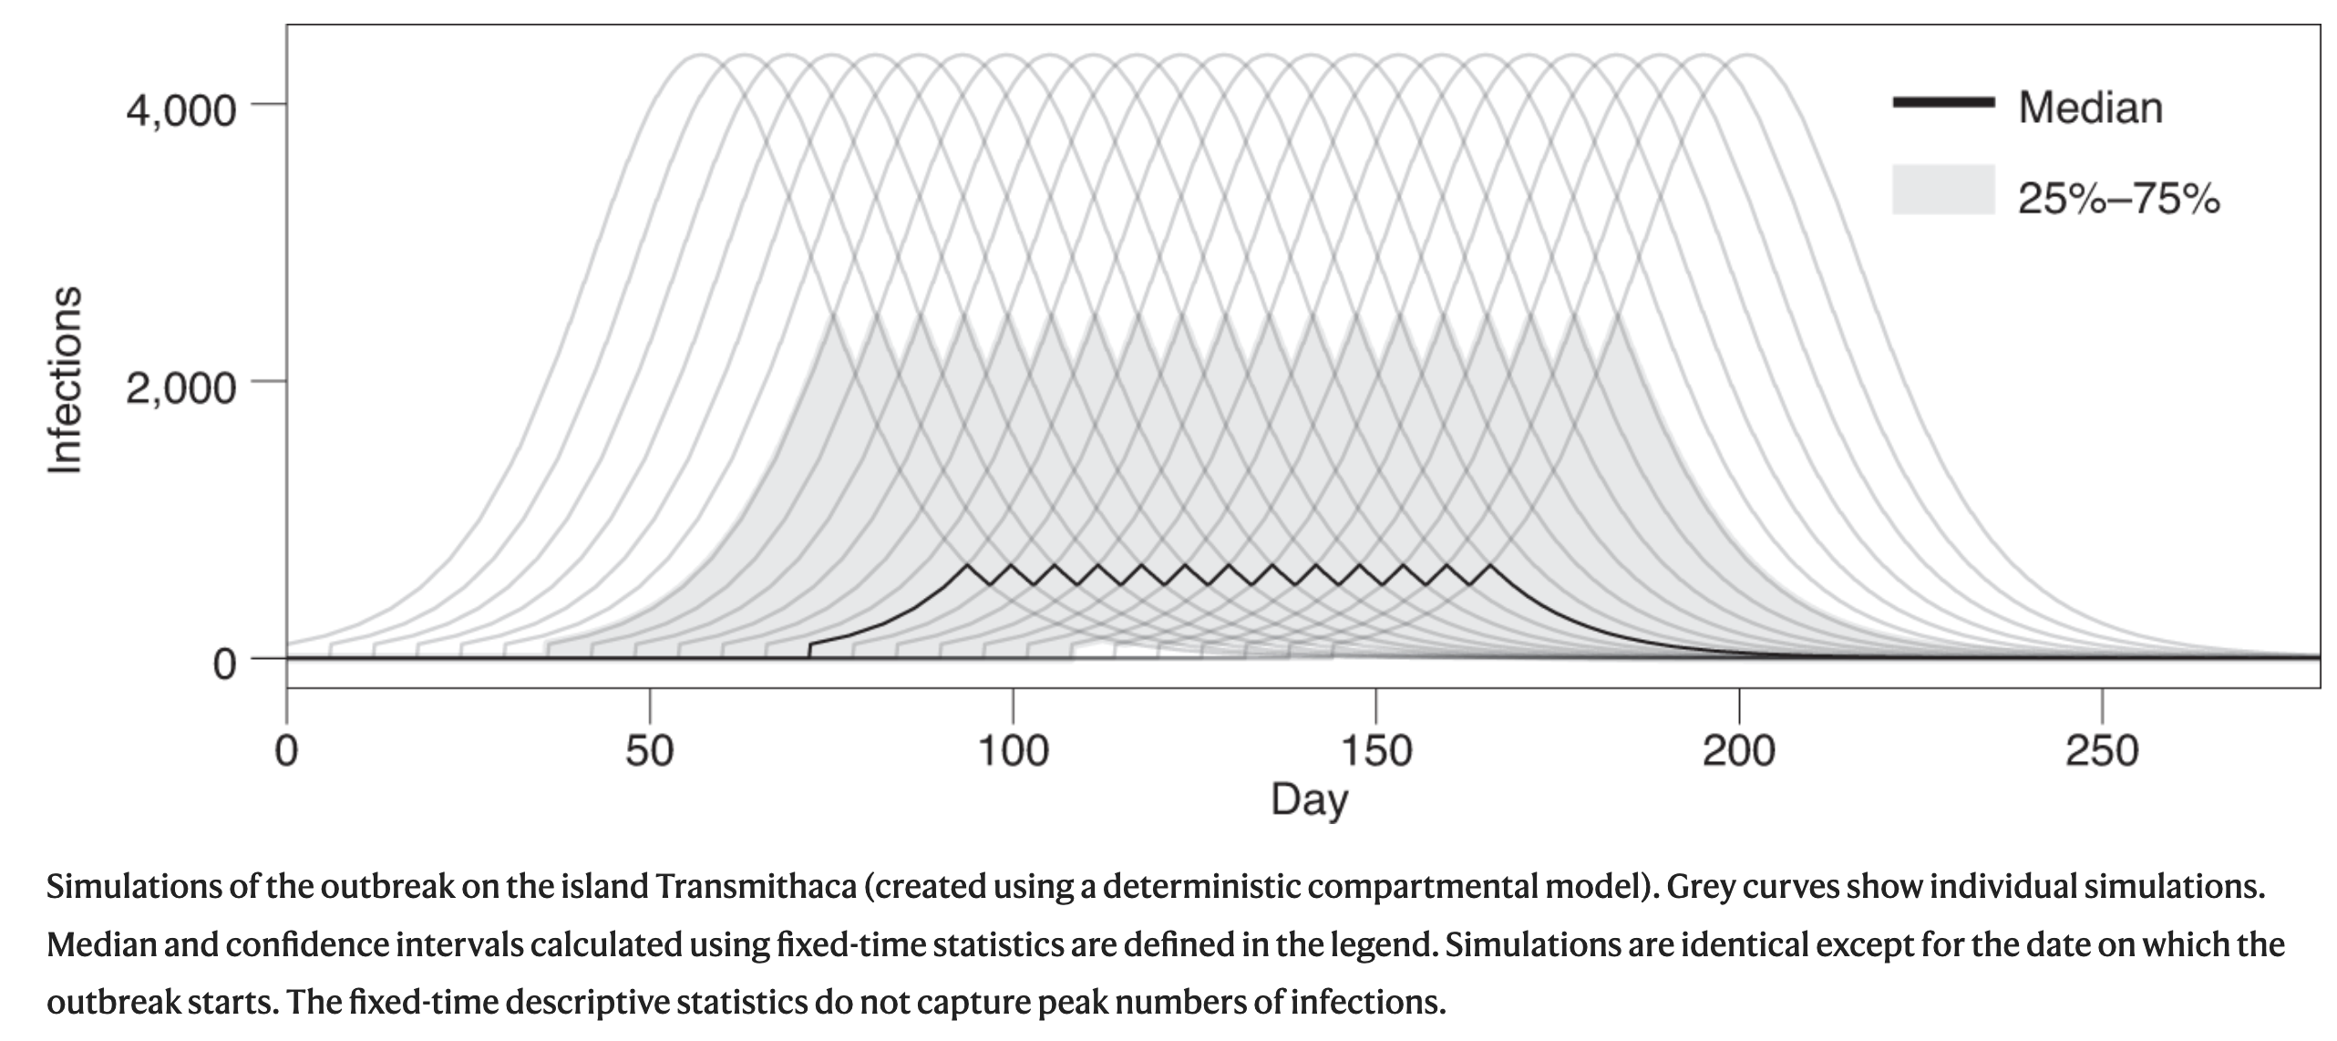
Pitfall 2: island of Transmithica
Juul et al. 2021. Fixed-time descriptive statistics underestimate extremes of epidemic curve ensembles

Slide 11
Pitfall 2: island of Transmithica
Concerns uncertain start dates
Affects:
Deterministic, stochastic, and agent-based models;
Regions that have no community outbreaks;
Models linking importation models to community spread models;
Ensemble forecasts of hospitalizations during the COVID-19 pandemic in the Netherlands (Juul et al. 2021)
Solutions (see Juul et al. 2021 for details):
(1) curve-based summary statistics
(2) summarizing estimated likelihoods of specific scenarios of interest

Slide 12
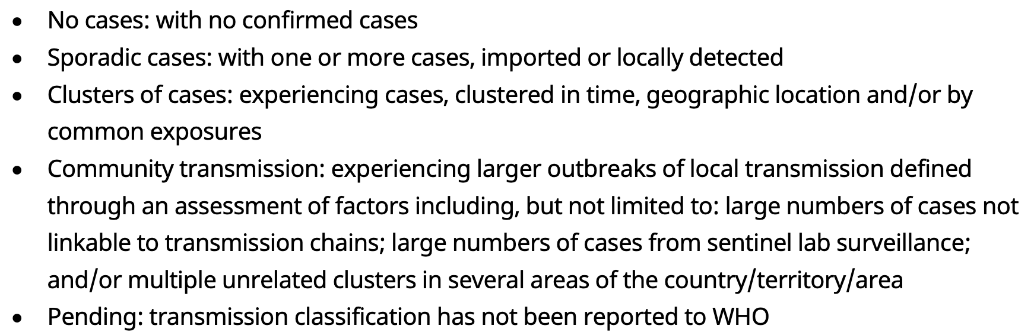
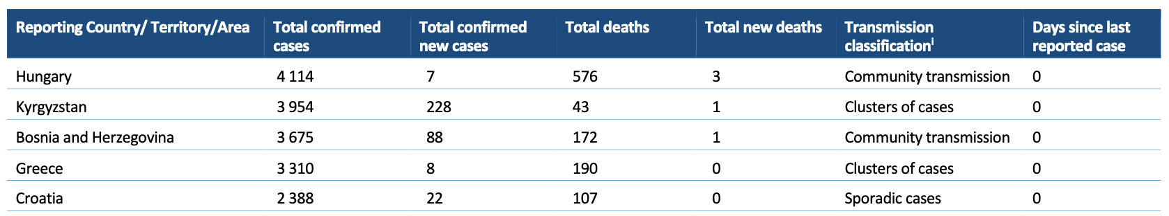
Pitfall 3: Over-generalization from regions with community spread
WHO coronavirus (COVID-19) situational report 157 – June 25 2020

Slide 13
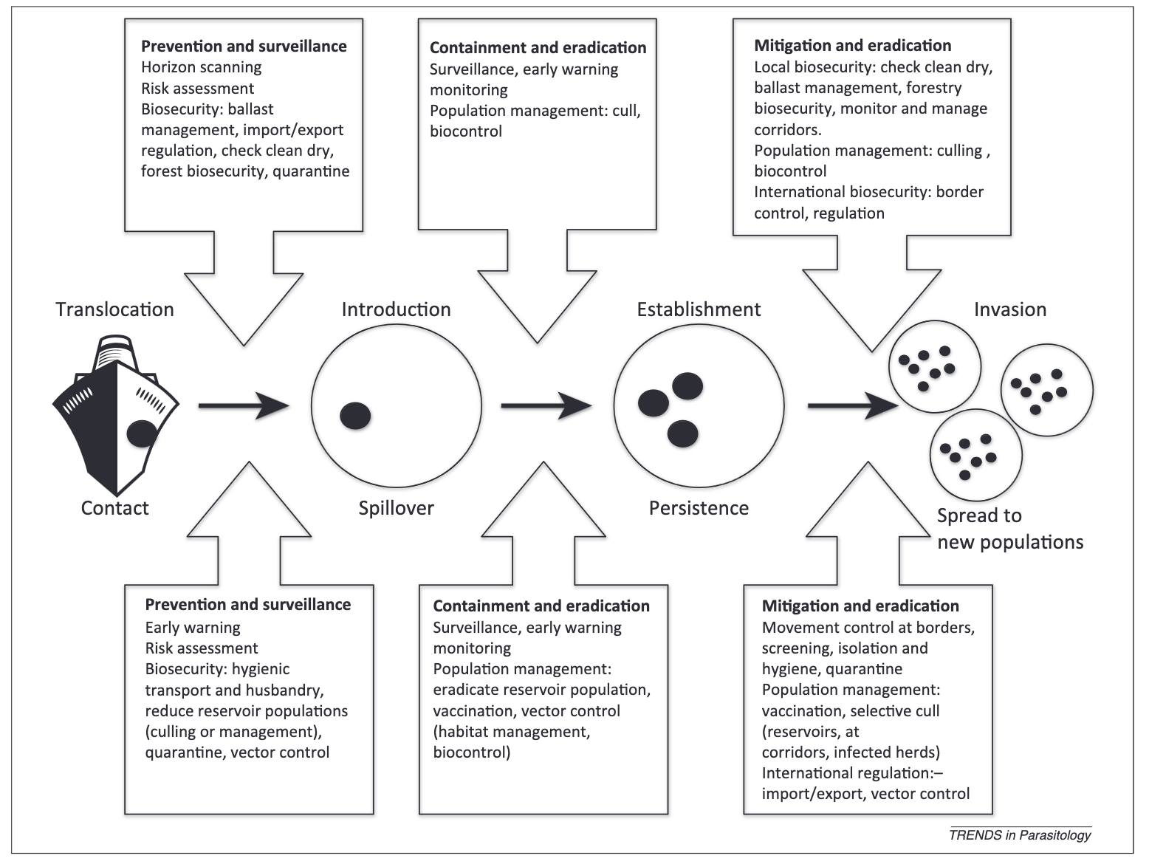
Chronological stages of risk
Dunn and Hatcher. 2015. Parasites and biological invasions: parallels, interactions and control

Slide 14
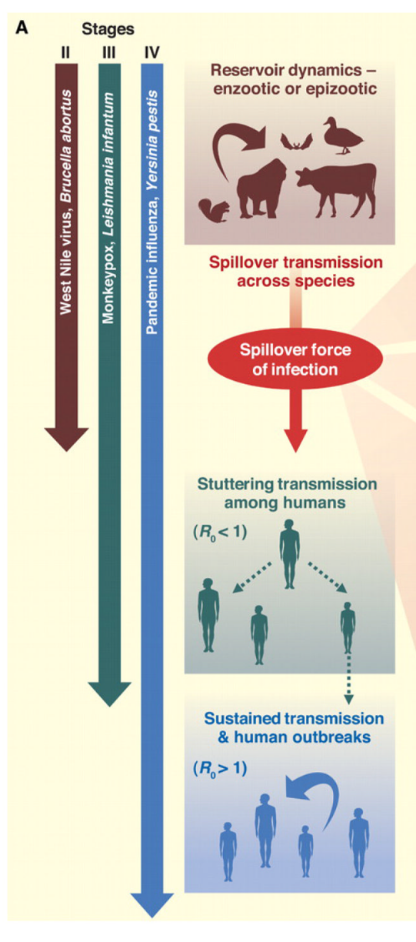
Insights from zoonotic spillover
For the COVID-19 pandemic, reframe this terminology as human-human spillovers from other regions:
Stage III: Stuttering transmission R_{t} < 1
Stage IV: Sustained transmission R_{t} > 1
The reservoir is another region rather than an animal
Lloyd-Smith et al. 2009. Epidemic dynamics at the human-animal interface.

Slide 15
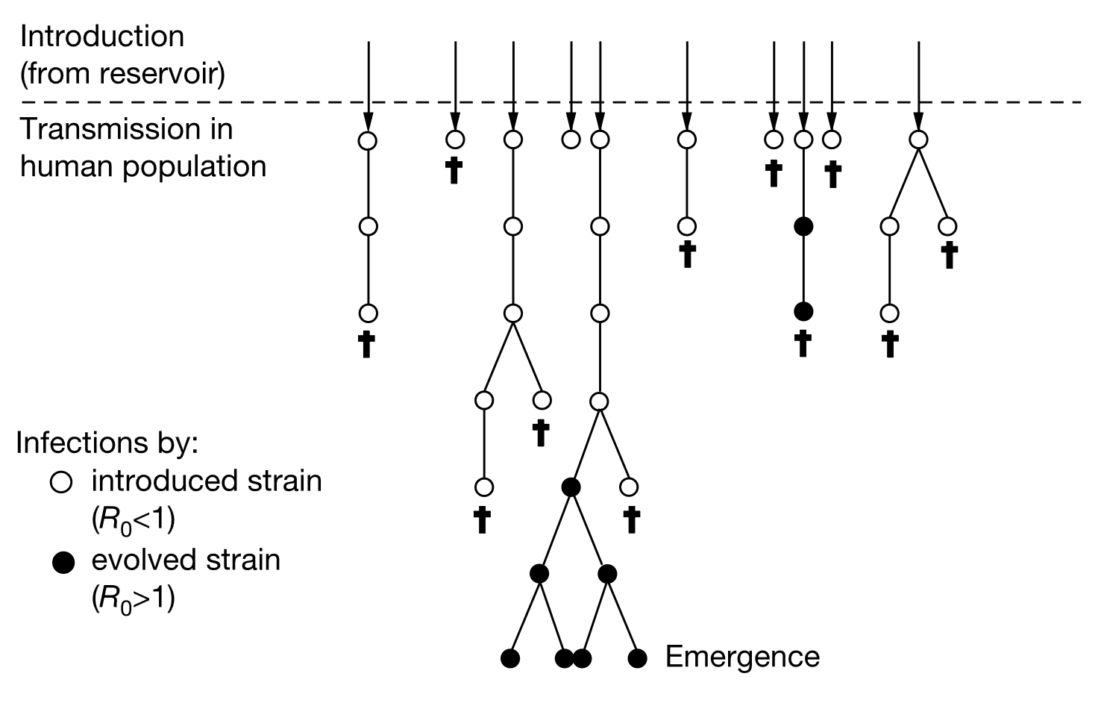
Stage III: Stuttering transmission
Antia et al. 2003. The role of evolution in the emergence of infectious disease

Slide 16
Stage III: Stuttering transmission (re-framed)

Slide 17
Pitfall 3: Over-generalization from regions with community spread
Concerns using community spreads models (i.e., SIR) and resulting recommendations in regions where community spread is not occurring
Affects:
Regions without community spread
Underserved and under-resourced jurisdictions
Solutions:
Do the modelling correctly
Multijurisdictional representation
Serving and resourcing all jursdictions
Canadian small jurisdictions modelling group (CanSJ)

Slide 18
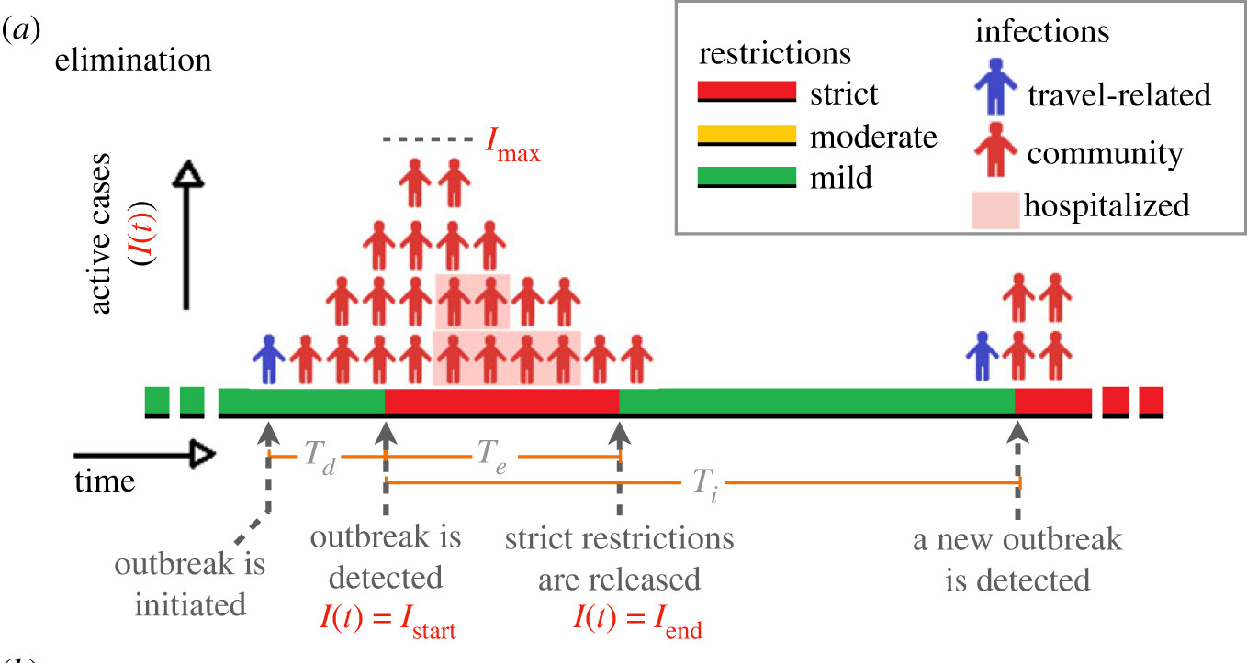
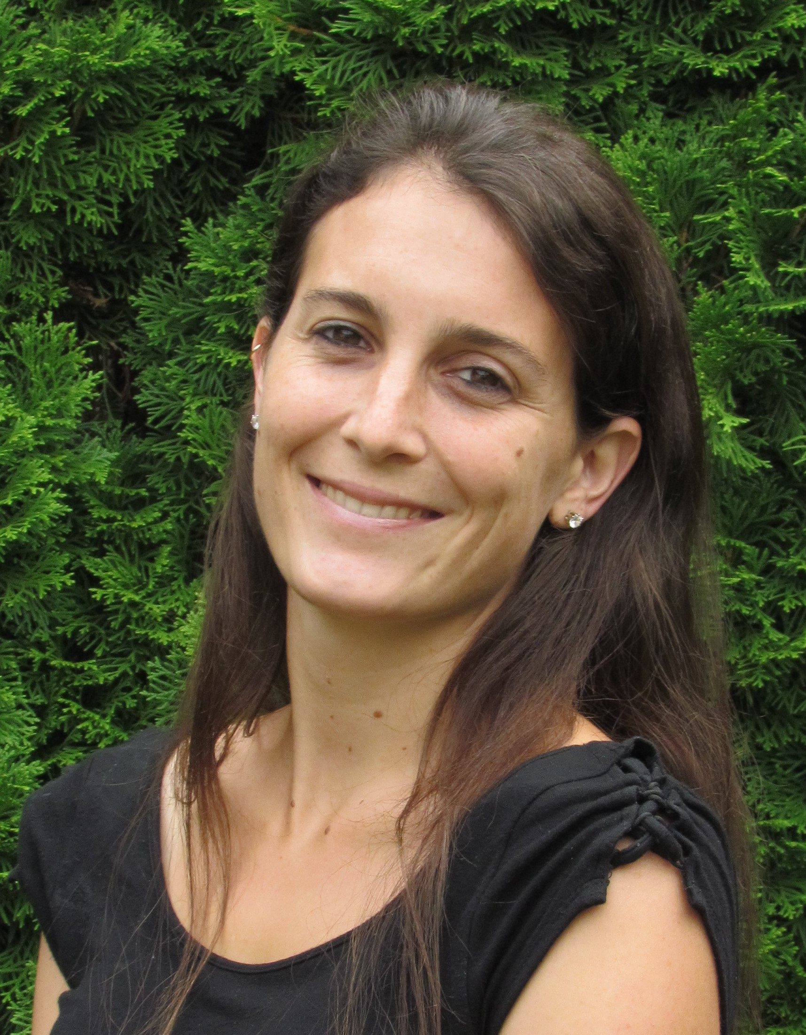
Fixes: Modelling outbreak duration and time between outbreaks
.
Dr. Maria Martignoni
Could be modelled as a branching process or an agent-based model, but atto-fox problem is “not so much about the determinism”.
Martignoni et al. 2024. Is SARS-CoV-2 elimination or mitigation best? Regional and disease characteristics determine the best strategy

Slide 19
Fixes: Modelling outbreak duration and time between outbreaks
Percentage of days with mild restrictions, T_{e} < T_{i}
.
Martignoni et al. 2024. Is SARS-CoV-2 elimination or mitigation best? Regional and disease characteristics determine the best strategy

Slide 20
Model fitting: importation-community spread switch model
Figure by Zahra Mohammadi, in collaboration with Steve Walker using macpan2 (unpublished)

Slide 21
Model fitting: importation-community spread switch model
Data: incidence of travel-related cases (dark shading) and community cases (light shading)
Include a model variable that is travelers in isolation
10 days before a reported community outbreak, briefly allow the rate that an isolating traveler infects a susceptible community members to be positive (vertical dashed line)
All other times this rate is 0
When infection incidence is less than a small threshold, set to 0.

Slide 22
Features of the importation-community spread switch model
Overcomes:
Pitfall 1 (atto-fox) by setting low incidence to 0
Pitfall 2 (island of Transmithica) by fixing the community outbreak start dates (vertical dashed lines). Start date is not treated as uncertain.

Slide 23
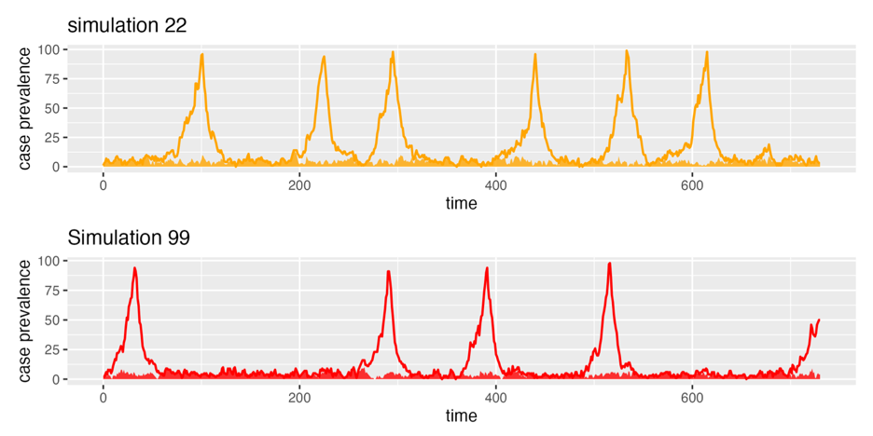
Scenario modelling, i.e. following from the switch model
Multiple realizations
DO: Av. number of community outbreaks Av. size of community outbreak Av. days without community cases DO NOT: Av. prevalence at a given time Consider the date meaningful
Community outbreak dates determined by travel-related cases (details next slide)
R_{t} > 1 except from when community cases ≥ 100 until elimination

Slide 24
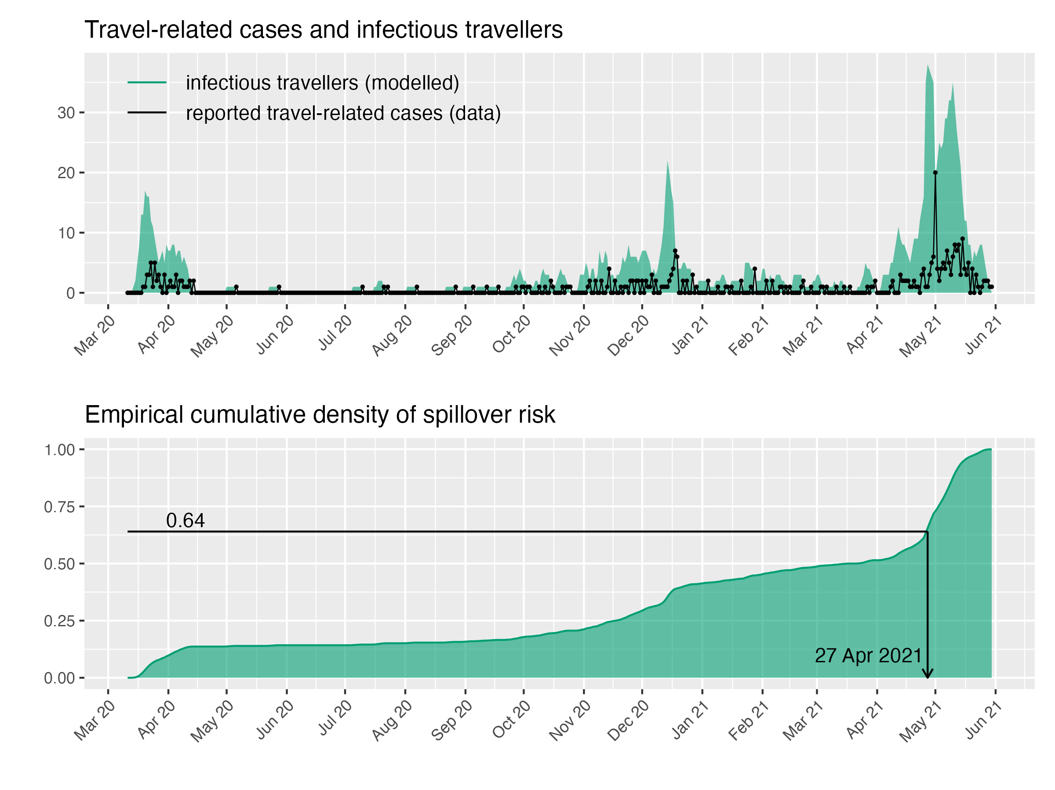
Determining when the outbreaks start for the scenario modelling
Use travel-related case data and a model to estimate infectious travelers (prevalence)
Use the inverse cumulative method to sample the start dates for community outbreaks from the empirical density of infectious travelers (prevalence)

Slide 25
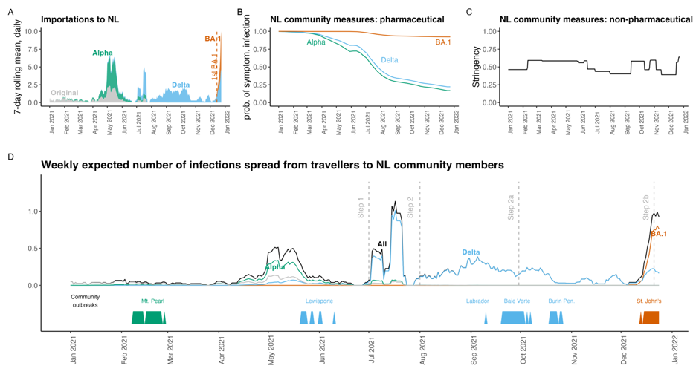
Determining when the outbreaks start for the scenario modelling
Extend this idea by using the same method for a more detailed spillover model
i.e., make D into a cumulative density and use inverse method
Hurford et al. 2023. Pandemic modelling for regions implementing an elimination strategy

Slide 26
Summary: what we learned about the modelling
Model outbreak duration and time between outbreaks (Martignoni et al. 2024)
Fit and simulate using the ideas of the importation-community spread switch model (unpublished)
We need general modelling frameworks, with the flexibility:
To model both clusters of cases and community transmission
Such that the complete range of public health responses are potentially optimal

Slide 27
The philosophy
Decisions about the types of models to use
Mechanistic models vs. statistical models
Agent-based models vs. compartmental models
Region-specific models: space stations vs. fire stations

Slide 28
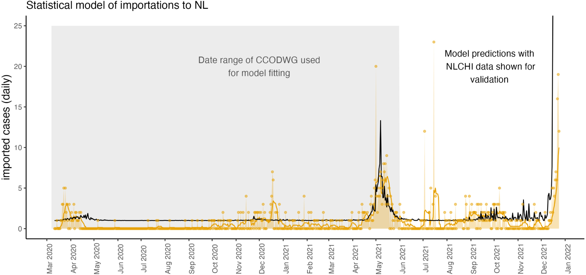
Travel-related cases reported in NL
Hurford et al. 2023. Pandemic modelling for regions implementing an elimination strategy

Slide 29
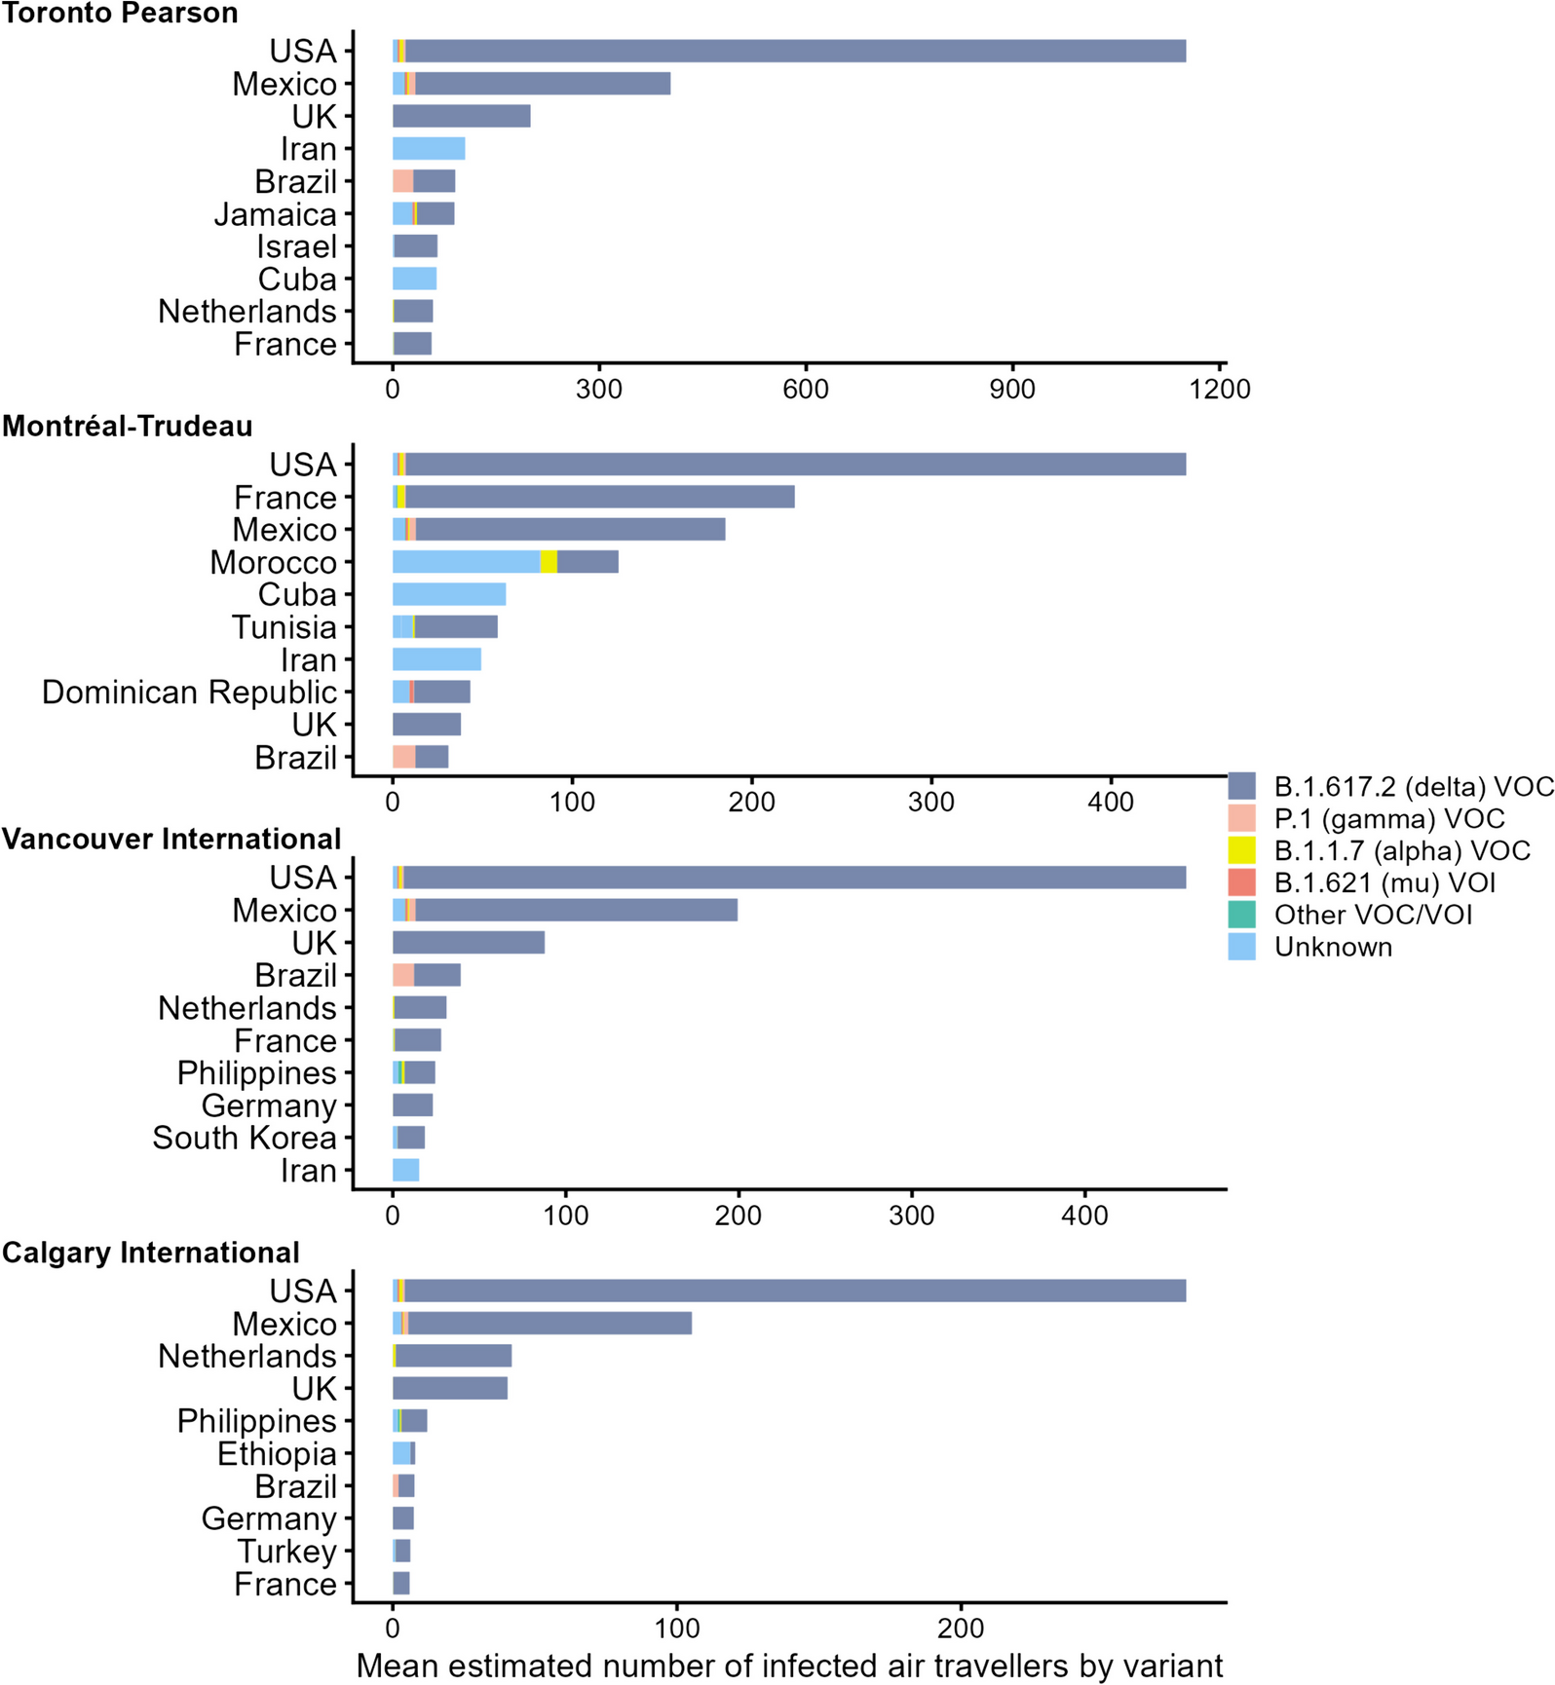
Model output for the mean number of SARS-CoV-2 infected air travellers by variant and country of departure arriving at their final destination in one of the four largest Canadian airports, as estimated from July 11 to November 27, 2021
Milwid, R.M., Gabriele-Rivet, V., Ogden, N.H. et al. A methodology for estimating SARS-CoV-2 importation risk by air travel into Canada between July and November 2021.

Slide 30
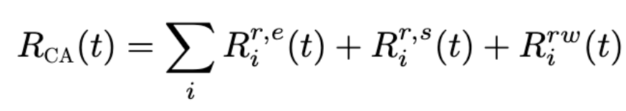
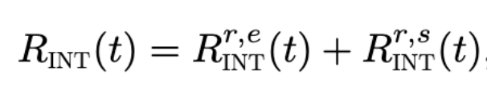
Mechanistic model for travel-related cases reported in NL
r: Regular travelers
rw: rotational workers
CA: Canadian origin
e: exposure notification
s: symptoms
i: province
INT: International origin

Slide 31
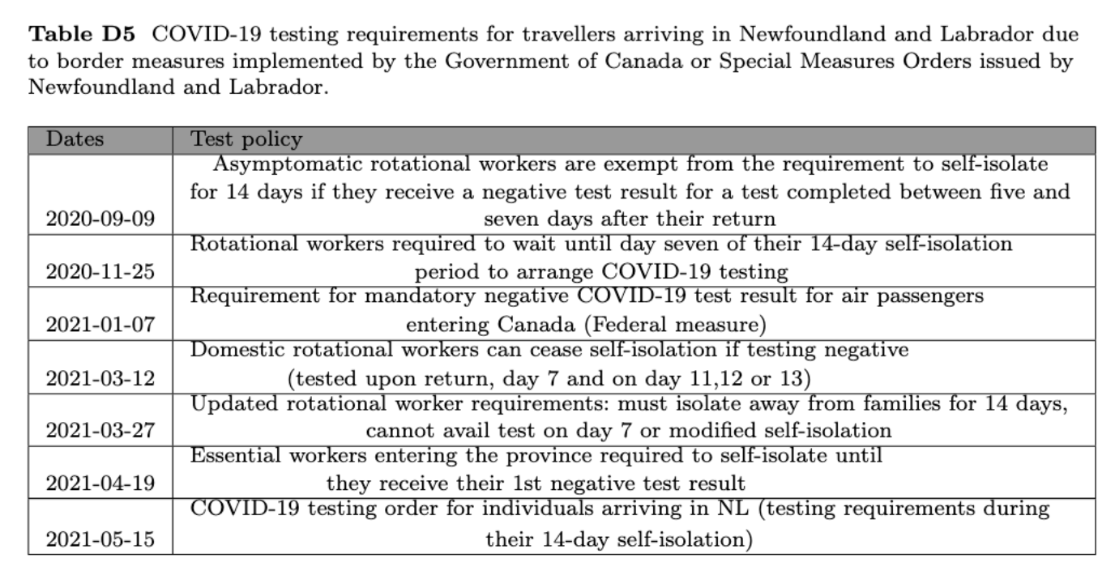

Slide 32
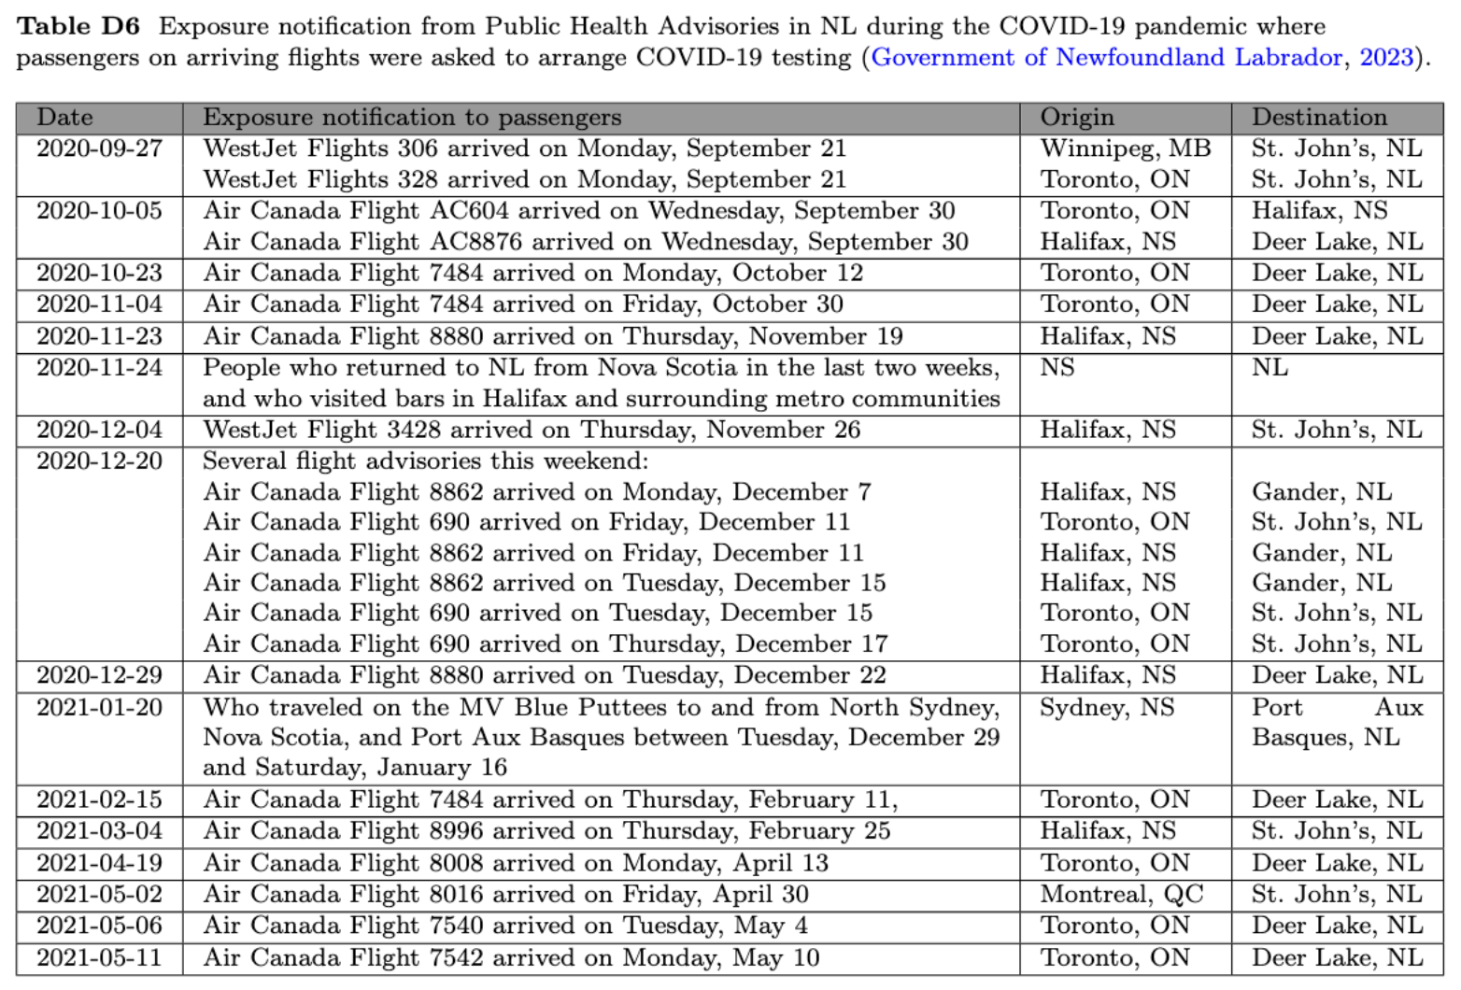

Slide 33
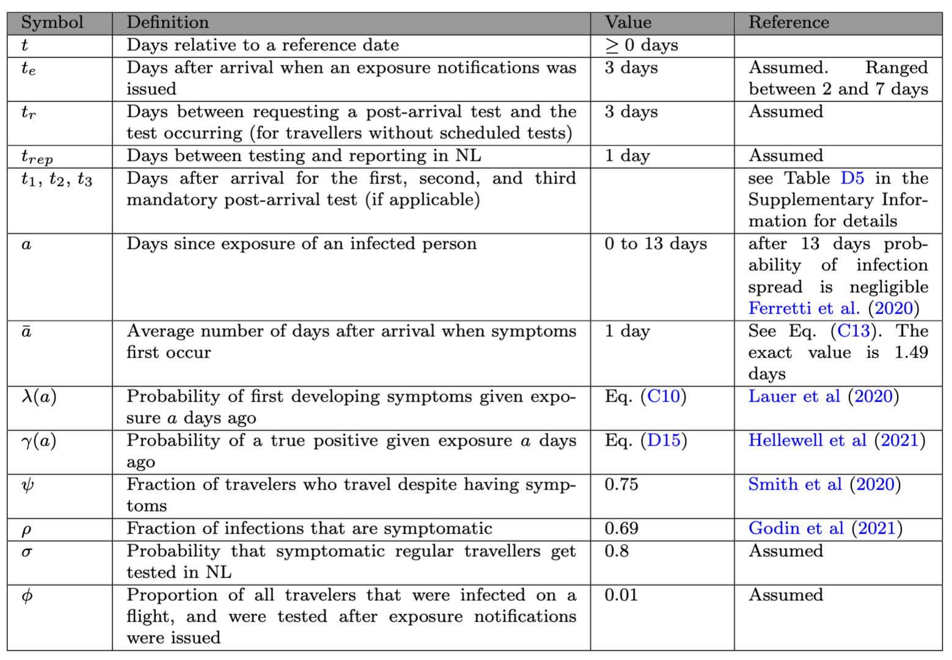
Mechanistic model parameters – none are fitted

Slide 34
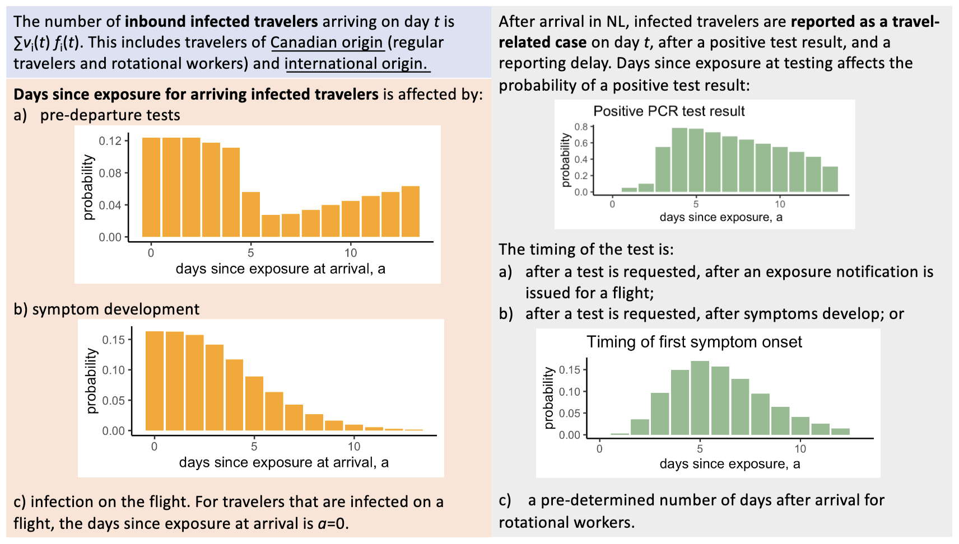

Slide 35
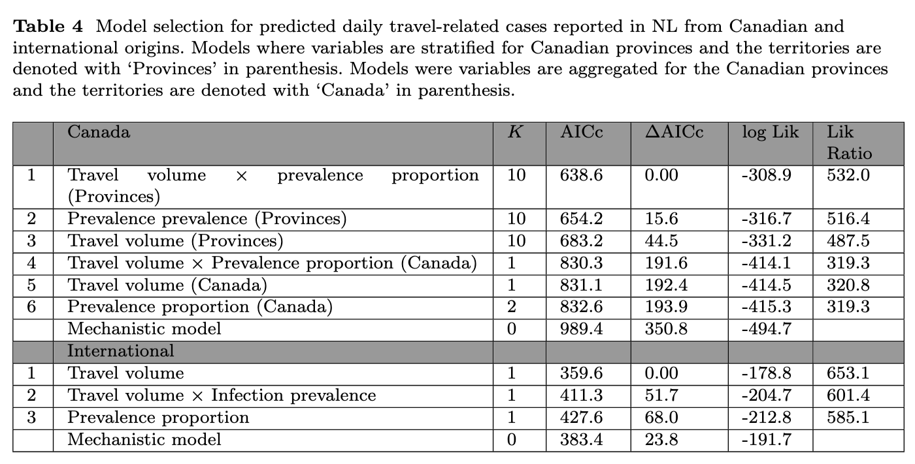

Slide 36
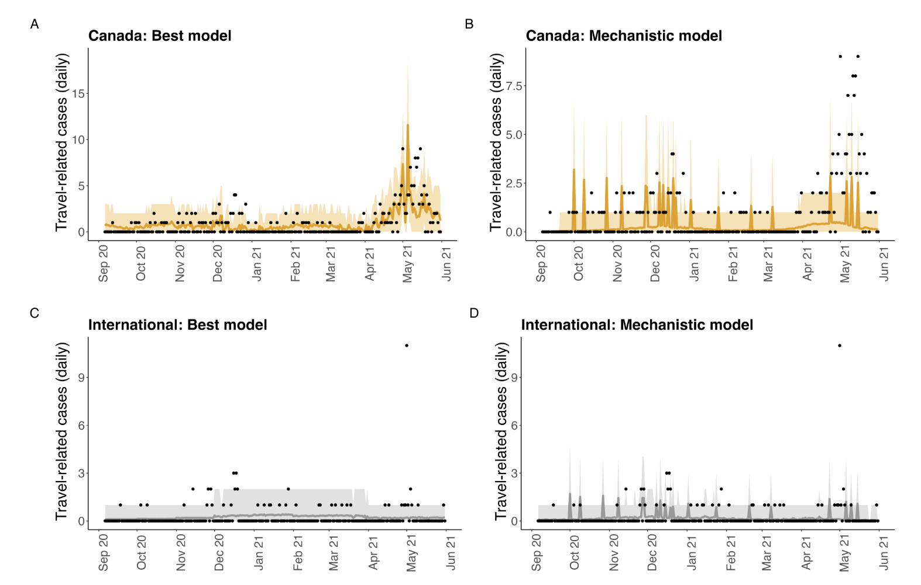

Slide 37
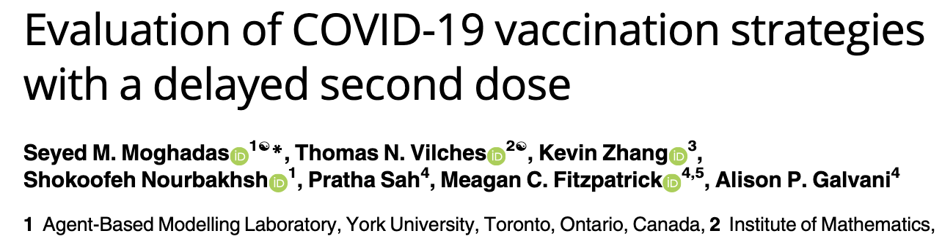
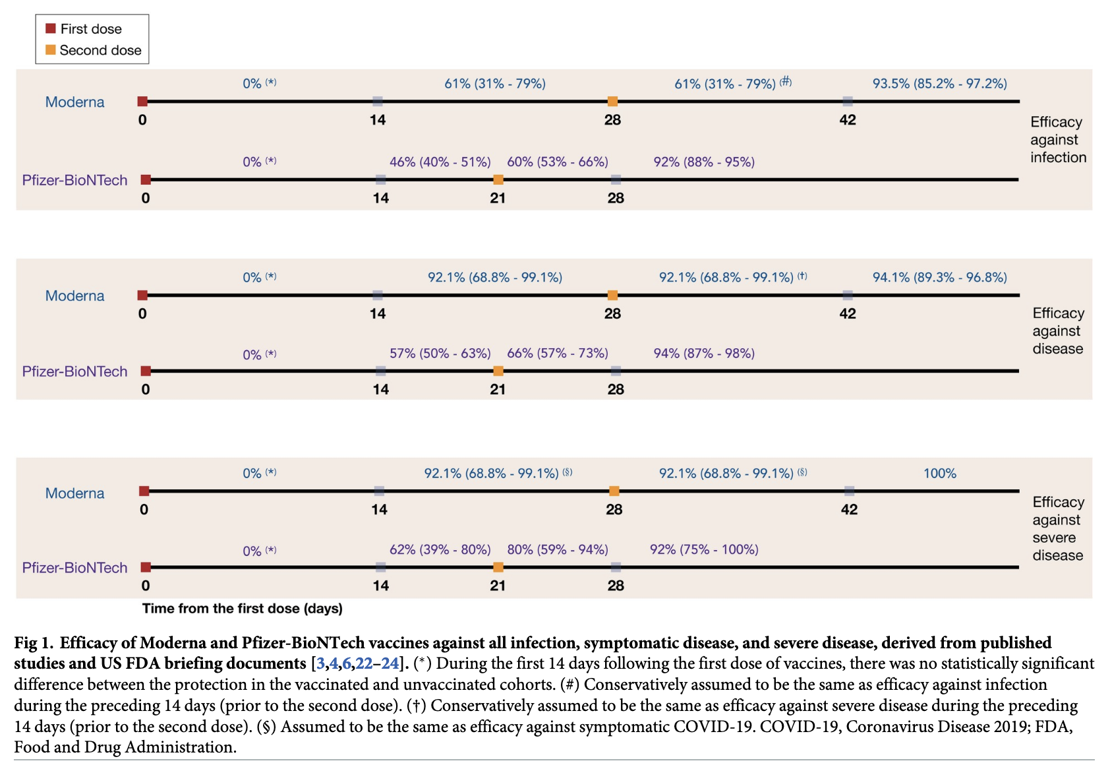
Agent-based models vs. compartmental models

Slide 38
Agent-based models vs. compartmental models
 | Fast results | Realistic assumptions | Few cases | Insight | Reference
Agent-based model | No | Yes | Yes | A little | Adams 2020
Stochastic model | Depends | Depends | Yes | Moderate | Bertozzi et al. 2020
Compartmental model | Yes | No | No | Yes | Arino et al. 2006; Adams 2020; Saltelli et al.; Bertozzi et al. 2020
 | Short-term predictions |  | Scenarios
Statistical model | Yes |  | No |  | Holmdahl and Buckee 2020
Mechanistic model | Yes |  | Yes |  | Funk and King 2020
Ensemble model | Yes |  | Yes |  | Adam 2020; Shea et al 2020
Notes:
Simulating the pandemic: What COVID forecasters can learn from climate models
The challenges of modeling and forecasting the spread of COVID-19
Bonbeau. Agent-based modeling: Methods and techniques for simulating human systems
Choices and trade-offs in inference with infectious disease models
Tooling-up for infectious disease transmission modelling
https://www.theguardian.com/commentisfree/2021/jan/04/covid-model-epidemic-collaboration-experiment

Slide 39
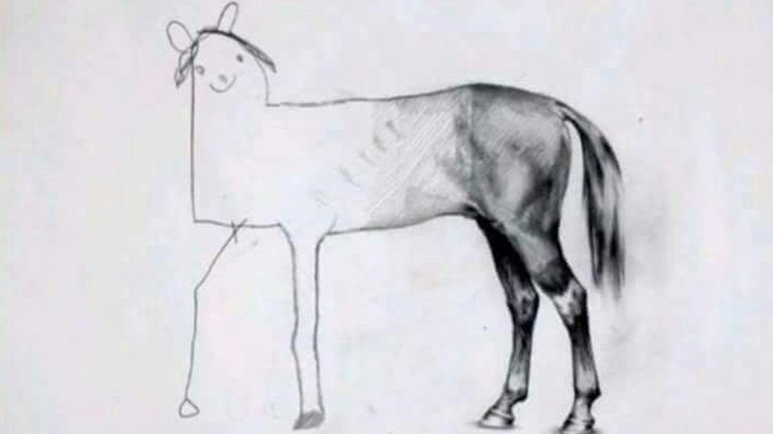
ABM vs. compartmental - conflation with model complexity
Importation model*
Spillover model*
Age-structured community spread
Gathering capacity limits in rural communities
Pfizer vs. Moderna
*only if no community spread
If many processes that need individual-level characteristics are at this end, then ABMs

Slide 41
Reasons for fire stations
Most of us experienced the COVID-19 public health emergency in primarily one place. Anecdotally, you need some local expertise or critical errors are likely (no slides on this – just recounting my observation)
Regional characteristics determine the best public health response
Small jurisdictions are under-resourced and their needs can be overlooked, or falsely assumed, in bigger conversations

Slide 42
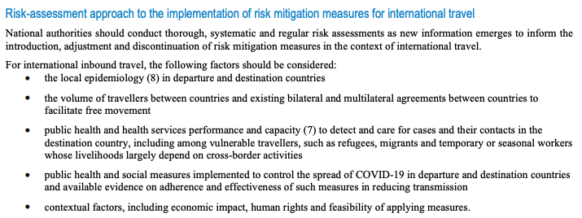
Fire stations: regional considerations determine the best public health response
2021 Updated WHO recommendations
Technical considerations for implementing a risk-based approach to international travel in the context of COVID-19 2 July 2021

Slide 43
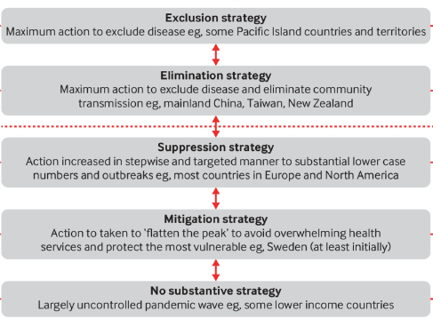
Fire stations: regional considerations determine the best public health response
A mitigation strategy can be continuous or circuit breaker
Baker et al. 2020. Elimination could be the optimal response strategy for covid-19 and other emerging pandemic diseases

Slide 44
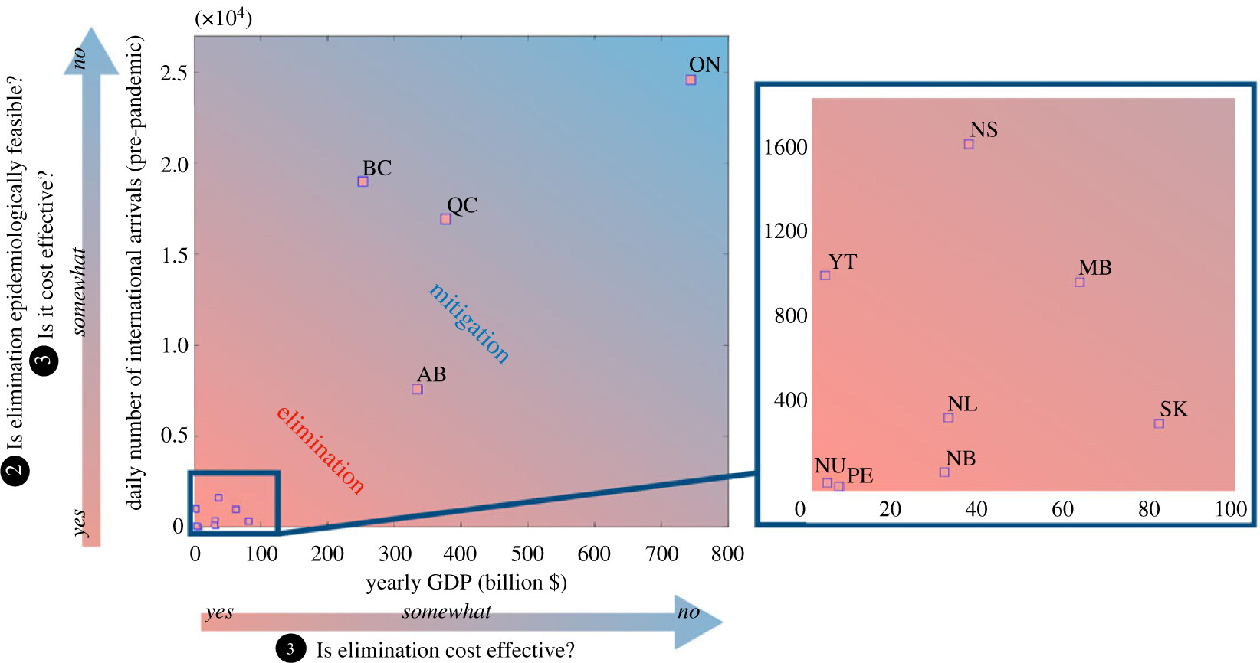
Martignoni et al. 2024. Is SARS-CoV-2 elimination or mitigation best? Regional and disease characteristics determine the best strategy

Slide 45
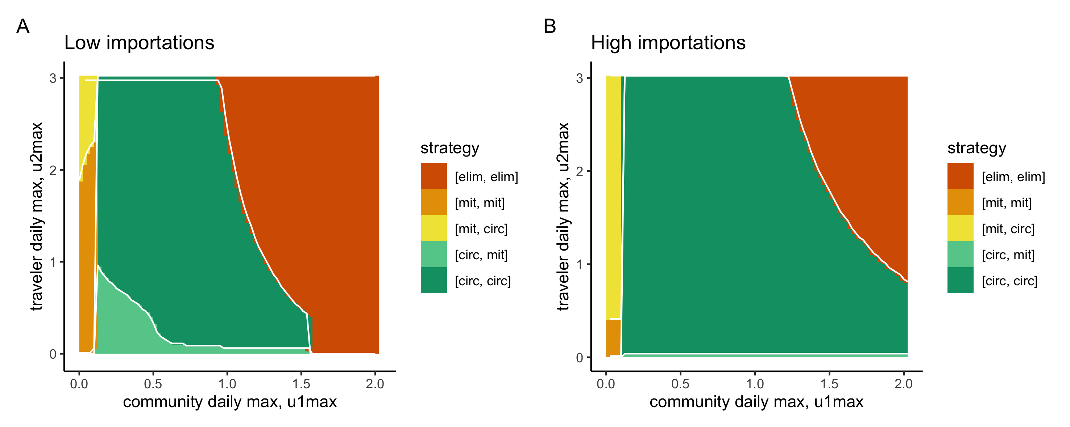
Optimal controls rephrased in the terminology of public health strategies
G. Adu-Boahen. Optimal Control Strategies in Epidemic Models: Analysis of Community and Traveler Isolation Strategies Under Resource Constraints. MSc thesis (incomplete). Model based on Hansen and Day. 2011. Optimal control of epidemics with limited resources

Slide 46
Summary: what we learned about the modelling
Model outbreak duration and time between outbreaks (Martignoni et al. 2024)
Fit and simulate using the ideas of the importation-community spread switch model (unpublished)
We need general modelling frameworks, with the flexibility:
To model both clusters of cases and community transmission
Such that the complete range of public health responses are potentially optimal

Slide 47
Small jurisdictions are under-resourced
“the need for additional public health physicians is most acute in rural areas, the Atlantic provinces, the territories and areas served by Health Canada’s First Nations and Inuit Health Branch".
--- 2003 report by the National Advisory Committee on SARS and Public Health

Slide 48
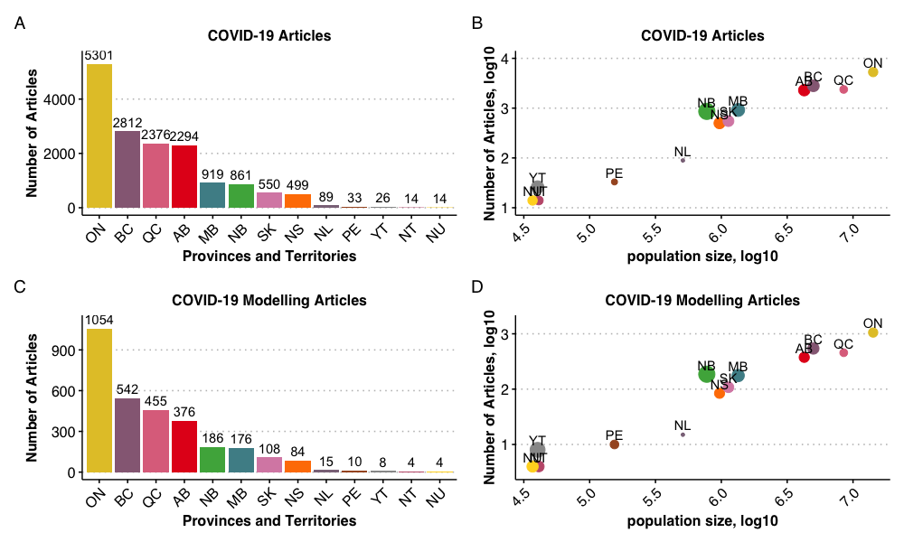
Small jurisdictions are under-resourced
Notes:
A PubMed search of peer-reviewed articles published from January 1, 2020 to September 17, 2023 using keywords “COVID-19” AND “SARS-CoV-2” AND (the name of each Canadian province and territory) finds: A) fewer articles published for Atlantic Canada and the territories; and B) the number of articles published is positively related to the population size of the provinces (dot size represents articles per individual in that provincial or territorial population). The PubMed search was repeated using additional keywords AND (Modelling OR Modeling OR Model). These same relationships also hold for COVID-19 modelling articles: C) fewer modelling articles published for Atlantic Canada and the territories; and D) the number of articles published is positively related to the size of the provincial or territorial populations. (reproduced from F. Anokye et al. in prep.)

Slide 49
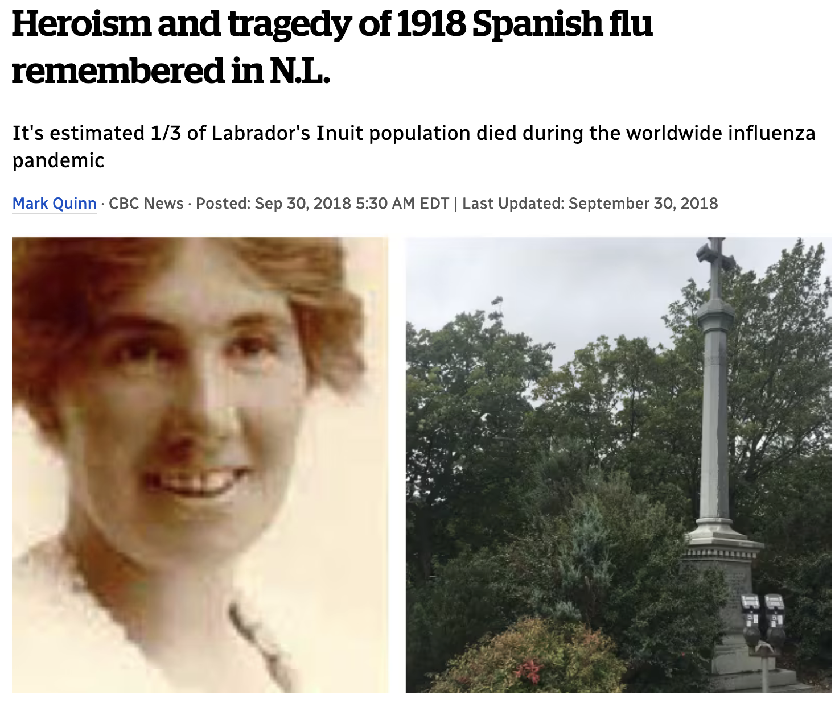
Small jurisdictions are not heard
American Samoa was one of the few places to report no mortalities from the 1918 influenza pandemic
Maritime quarantine, including several day wait period before disembarking maintained until at least 1920
Outbreak in 1926 resulted in clinical infections in 25% of the population;
1/1000 residents died, ~200 lower than overall mortality in nearby Western Samoa
Shanks and Bundage. 2012. Pacific islands which escaped the 1918–1919 influenza pandemic and their subsequent mortality experiences

Slide 50
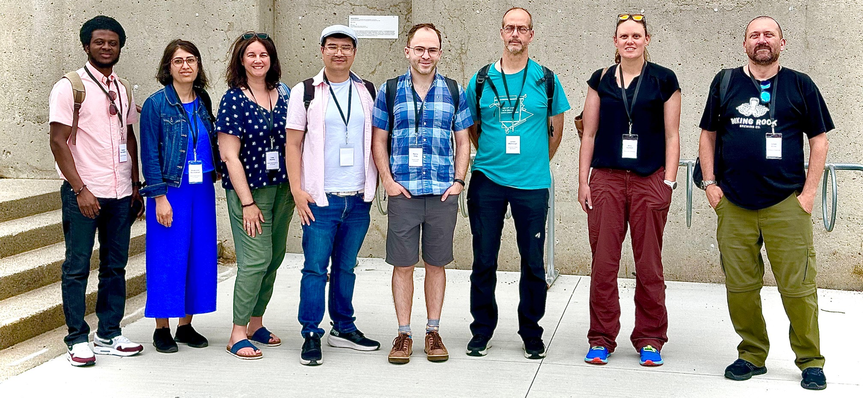
Small jurisdictions are not heard
Canadian Small Jurisdictions Working Group (CanSJ)

Slide 51

Reasons for space stations
Under-resourced jurisdictions need access to the best experts too!

Slide 52
Summary: what we learned about modelling philosophy
Mechanistic modelling is under-valued
Both simple compartmental models and ABMs are needed
Region-specific modelling is needed. Can be achieved by
Building modelling capacity in regional public health (fire stations);
Regional experts in an adjacent field with support from modeling experts (space station collaboration)
Multijurisdictional representation on modelling networks

Slide 53
The profession (NSERC-based infectious disease modeller)
Reflecting on the emergency response, the actual modelling may have mattered less than the relationships
Groups of colleagues (CANMOD, OMNI-REUNIS, MfPH, PHAC External Experts Group)
Interdisciplinary groups (NL Predictive Analytics team, Ontario Science Table & Modelling Consensus Table)
Referrals from colleagues to establish new relationships
Decision-makers (CMOHs)
Public (media and knowledge translation experts such as NCCID)
Pandemic preparedness means also establishing the relationships, and organizing your group of colleagues

Slide 54
The profession (NSERC-based infectious disease modeller)
We need to:
Advocate for mathematical modelling as critical to pandemic preparedness and the emergency response
Build relationships, particularly with medical disciplines
Participate in cross-disciplinary activities
Do training and knowledge translation on how to do good modelling
Keep in mind:
developing new models (NSERC)
health applications of existing math models (CIHR)
Be resilient
NSERC. Addendum to the guidelines for the eligibility of applications related to health

Slide 55
Pandemic preparedness needs modelling preparedness What the COVID-19 pandemic taught us about the modelling, the philosophy, and the profession
Amy Hurford

Slide 56
Acknowledgments
Memorial U Proton Rahman; J.C. Loredo-Osti; Maria Martignoni; Francis Anokye; Joshua Renault; Joesph Baafi; George Adu-Boahen
Guelph U Zahra Mohammadi; Monica Cojocura
PHAC Michael WZ Li; Nicholas Ogden; Lisa Kanary
McMaster U Steve Walker
NLHS – Digital Health Kendra Lester; Alicia Blackmore
U Manitoba Julien Arino
U New Brunswick James Watmough
Simon Fraser U Caroline Colijn; Renny Doig; Liangliang Wang
NLHS Suzette Spurrell; Andrea Morrissey
CanSJ

Slide 57


My sincerest thanks to the Maud Menton Institute!

